Slide 1

Predicting Future MLB Hall-of-Fame Players
&
Past Snubs, Outliers
Daniel Daye

Slide 2


Table of Contents
Introduction
Part 1: Stat Comparison
Part 2: Predictions and Analysis
Future Steps
Issues Faced

Slide 3

Introduction
Use past data to determine baseball Hall of Fame (HoF) threshold
Determine if past players were worthy or unworty of their HoF status, whether inducted or not
Predict future baseball Hall of Famers

Slide 4
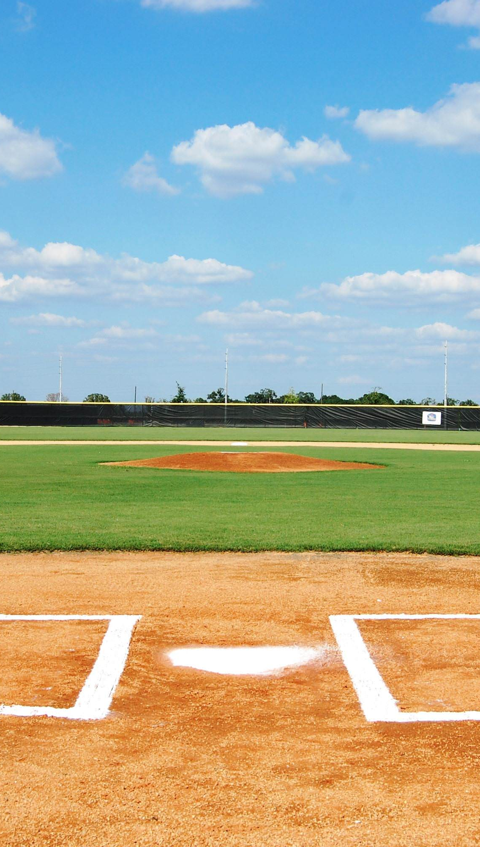
Introduction (Cont.)
Using data from Baseball-Reference, create four datasets based on criteria:
All hitters inducted into the HoF (273,32)
All pitchers inducted into the HoF (121,37)
All hitters not inducted into the HoF with at least 162 games played (7102,32)
All pitchers not inducted into the HoF with at least 32 games played (5806,37)

Slide 5
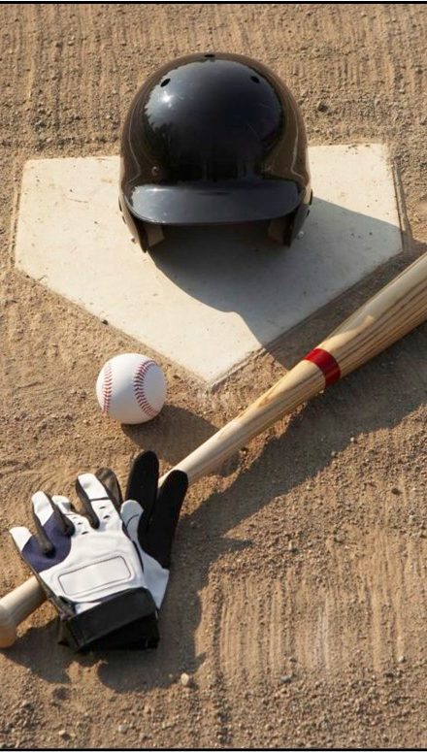
Introduction (Cont.)
Plot certain stats for Non-HoF and HoF players against each other to get a visual comparison
Establish a threshold for HoF induction to determine if current players are on pace for induction
Analyze past players to see if their HoF status is appropriate

Slide 6
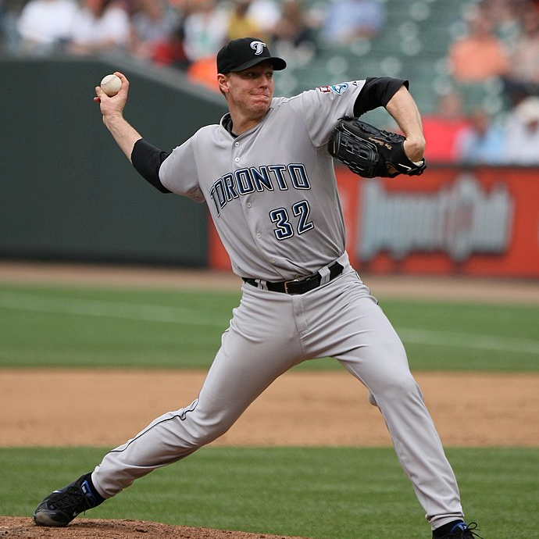
Part 1: Stat Compare – HoF vs Non-HoF

Slide 7
Main Stats Analyzed
Hitters Stats
Pitchers Stats
BA
Batting Average
OBP
On-base Percentage
SLG
Slugging Percentage
OPS
On-base + Slugging
OPS+
On-base + Slugging Plus
ERA+
Adjusted Earned Run Average Plus
FIP
Fielding Independent Pitching
WHIP
Walks and Hits per Inning Pitched
SO/BB
Strikeout to Walk Ratio (Sometimes displayed as K/BB)

Slide 8

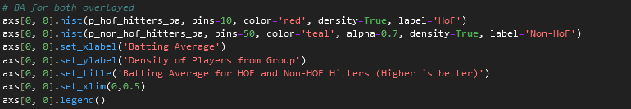
Method
Imported datasets for each group (HoF Hitters, Non-HoF Hitters, HoF Pitchers, Non-HoF Pitchers)
Filter out opposite position players from respective HoF datasets (BA >= 0.240 for HoF Hitters, Games Played (pitcher) >= 32 for Pitchers)
Plot histograms of players selected stats from both HoF and Non-HoF groups on the same axis.

Slide 9

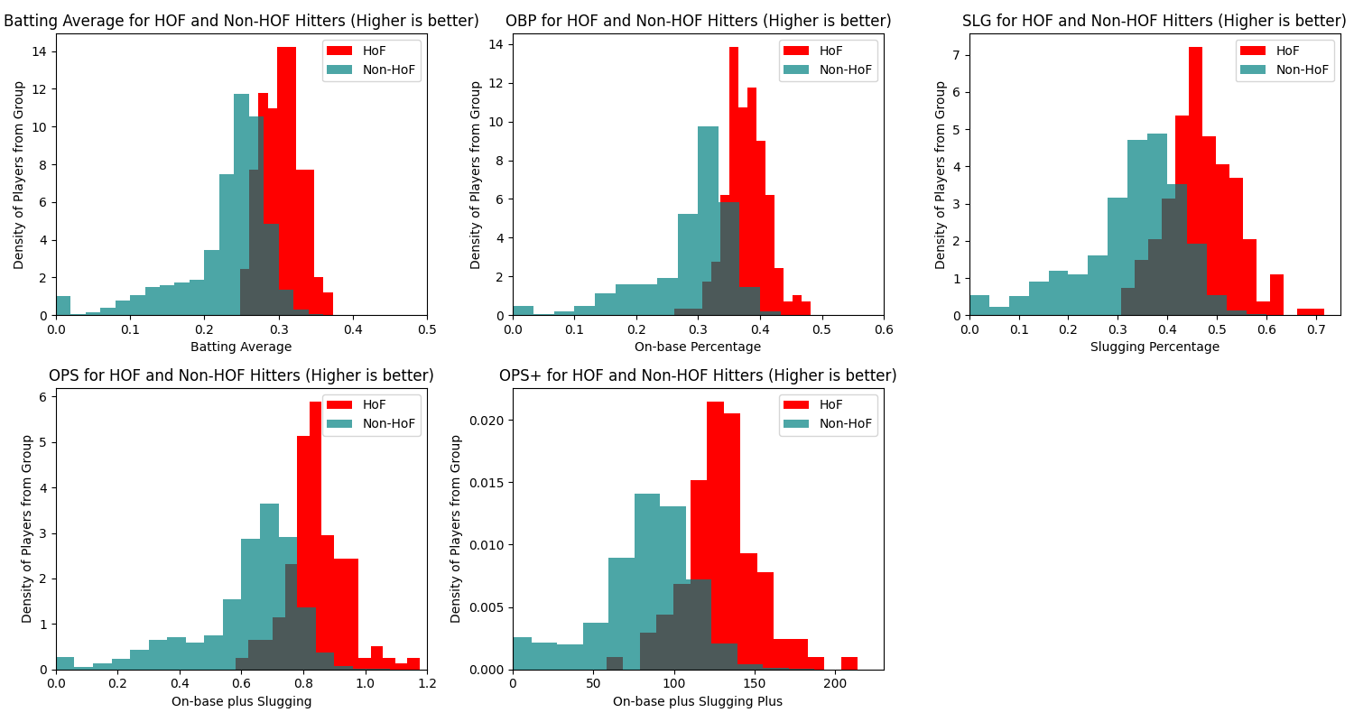

Slide 10
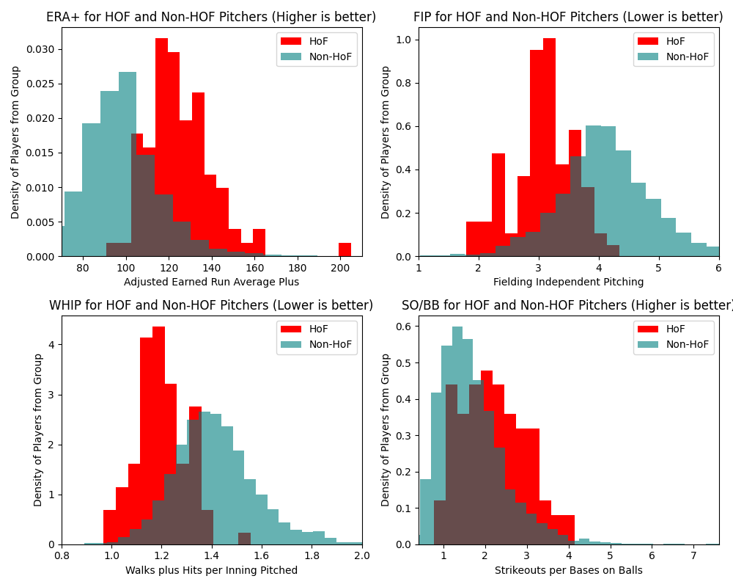

Slide 11
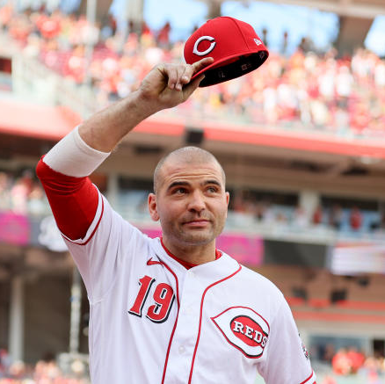
Part 2: Predictions and Analysis

Slide 12
Method
Combined HoF and Non-HoF players datasets (for both hitters and pitchers) and added HoF column to denote HoF status.
Split data into two groups – for those who last played pre-2020, and those who played since 2020.
Imputed missing values and scaled data.
Trained and tested support vector machine (SVM) model on pre-2020 players data, created confusion matrix.
Used results of matrix to determine predicted non-HoF players who made the HoF, and predicted HoF players who did not make the HoF.

Slide 13
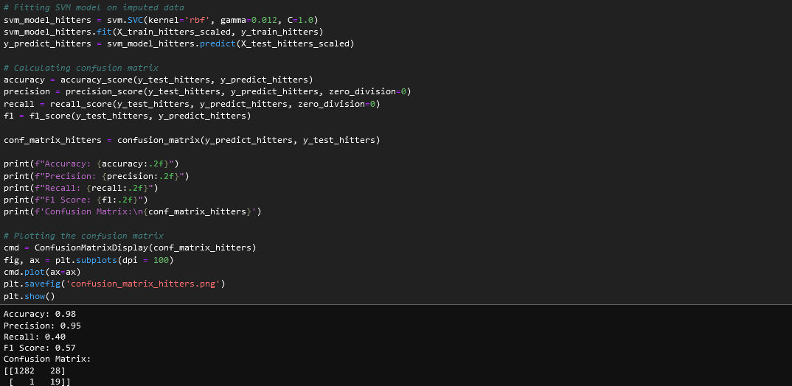

Slide 14
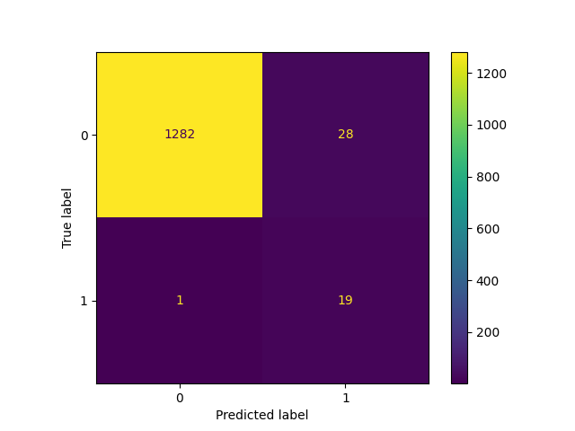
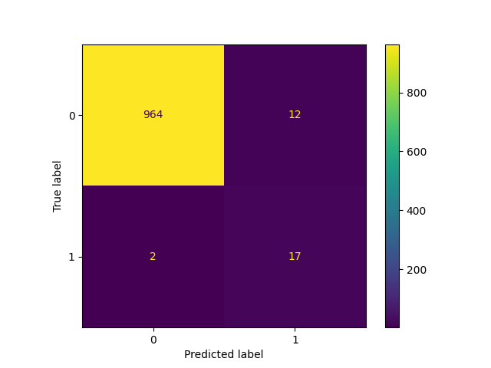
Confusion Matrices
Hitters
Pitchers
Non-HoF label = 0, HoF label = 1

Slide 15
Results
Predicted Non-HoF but actually HoF
(Players from opposite group omitted)
Predicted HoF but actually Non-HoF
(Players from opposite group omitted)
Hitters
Johnny Bench
Roger Bresnahan
Roy Campanella
Jimmy Collins
Earle Combs
Buck Ewing
George Kell
Joe Mauer
Kirby Puckett
Ryne Sandberg
Ray Schalk
Ozzie Smith
Hack Wilson
Pitchers
Ray Brown
Jack Chesbro
Waite Hoyt
Bob Lemon
Joe McGinnity
Jack Morris
Hilton Smith
Hitters
George Van Haltren
Pitchers
Tommy John
Smoky Joe Wood

Slide 16
Method
On data for players since 2020, computed decision scores and determined HoF threshold.
Plotted decision scores with threshold and marked all players above threshold.
Decision score is the SVM model’s confidence in a players HoF status based on players stats. The threshold was set visually by looking at the plot of all players decision scores.
If players exceeded threshold, they are predicted to be inducted into the HoF when eligible.

Slide 17
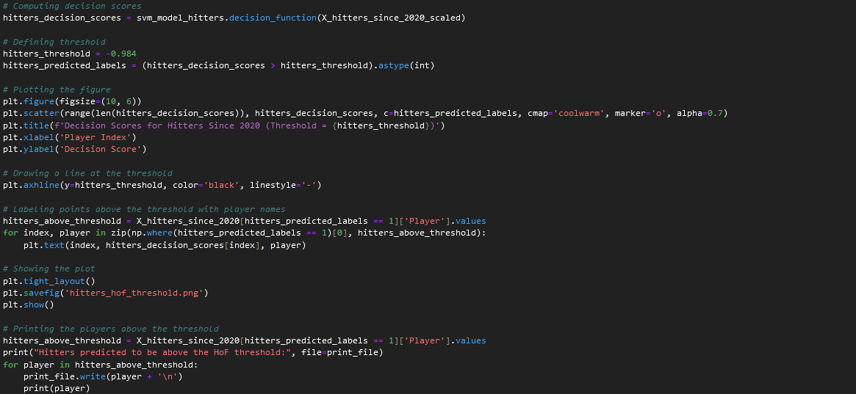

Slide 18
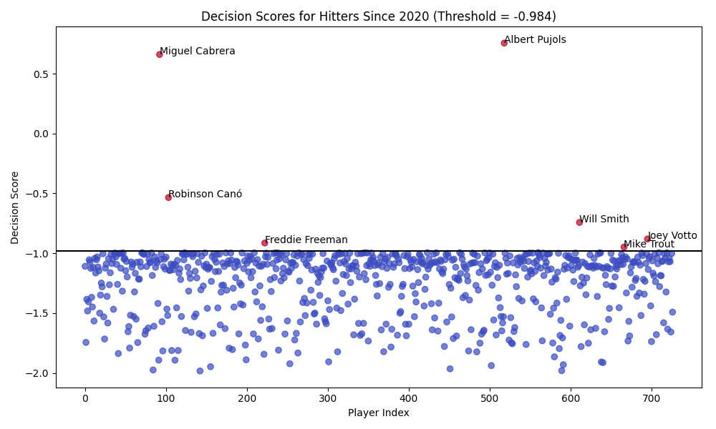

Slide 19
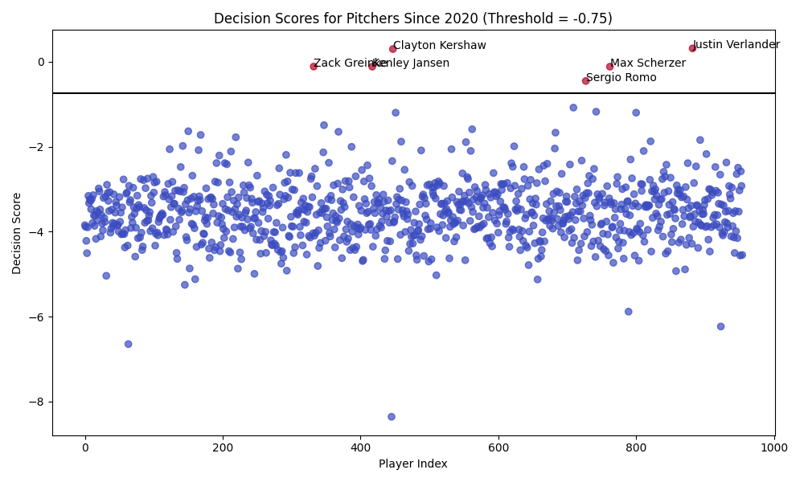

Slide 20
Predicted Future Hall-of-Famers
Hitters
Miguel Cabrera
Robinson Canó
Freddie Freeman
Albert Pujols
Will Smith
Mike Trout
Joey Votto
Pitchers
Zack Greinke
Kenley Jansen
Clayton Kershaw
Sergio Romo
Max Scherzer
Justin Verlander

Slide 21
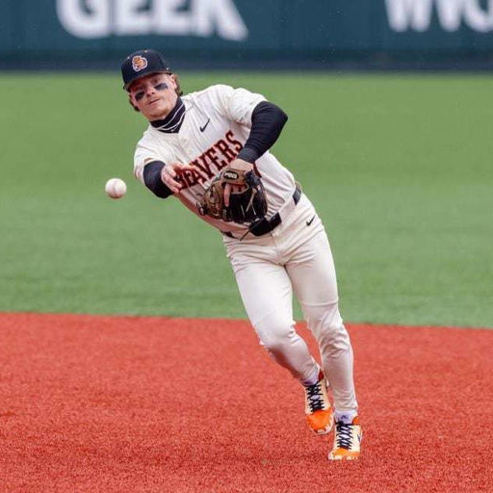
Future Steps

Slide 22

Applying Model to Minor Leagues
Examine current HoF players stats from when they were in the minor leagues
See how their stats compared to other minor leaguers
Test to see if model predicts HoF players from their minor league stats
Train model to predict future HoF players based on their minor league stats

Slide 23
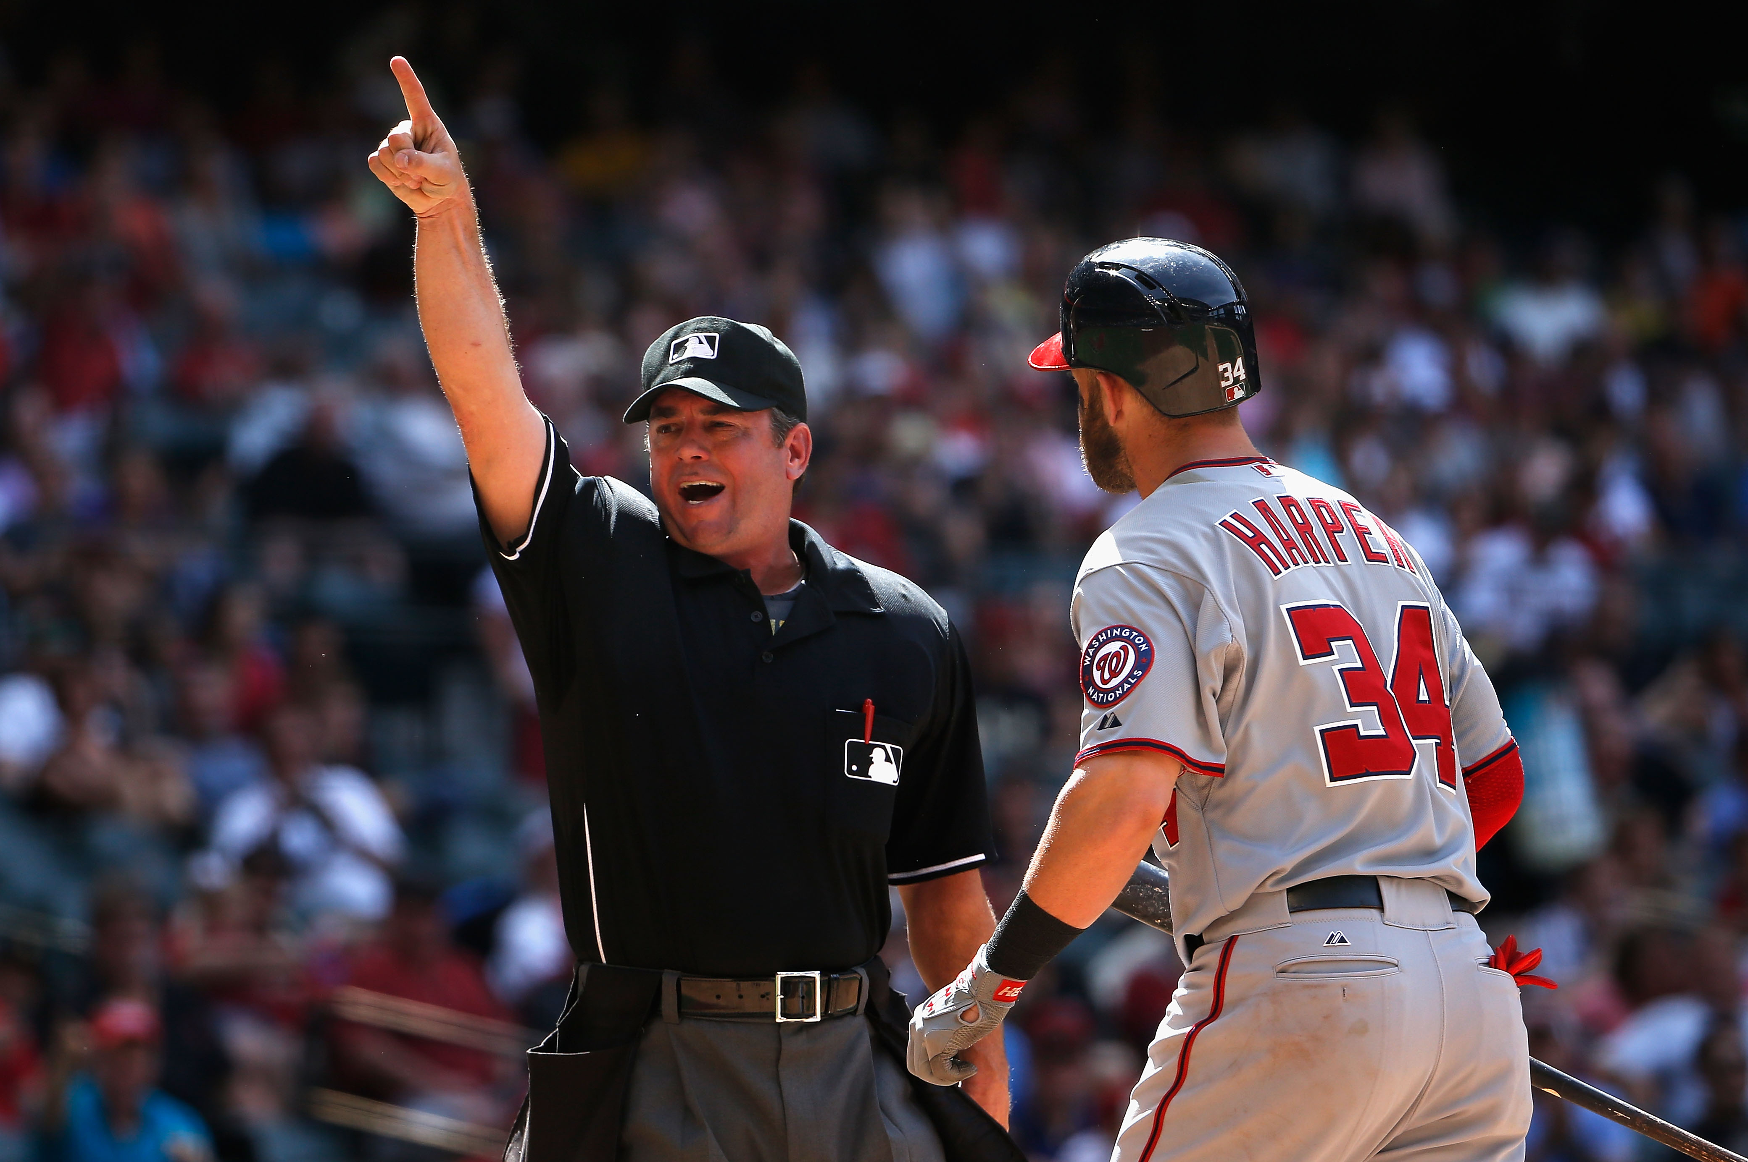

Issues Faced
Determining which stats to analyze (no WAR, wRC+, etc.)
Excluding postseason stats
Filtering players based on criteria (Games played, BA, etc.)
Players in opposing group datasets (HoF pitchers being included in HoF hitters dataset, etc.)
Determining decision score Threshold
Difference in dataset size between HoF and non-HoF players

Slide 24
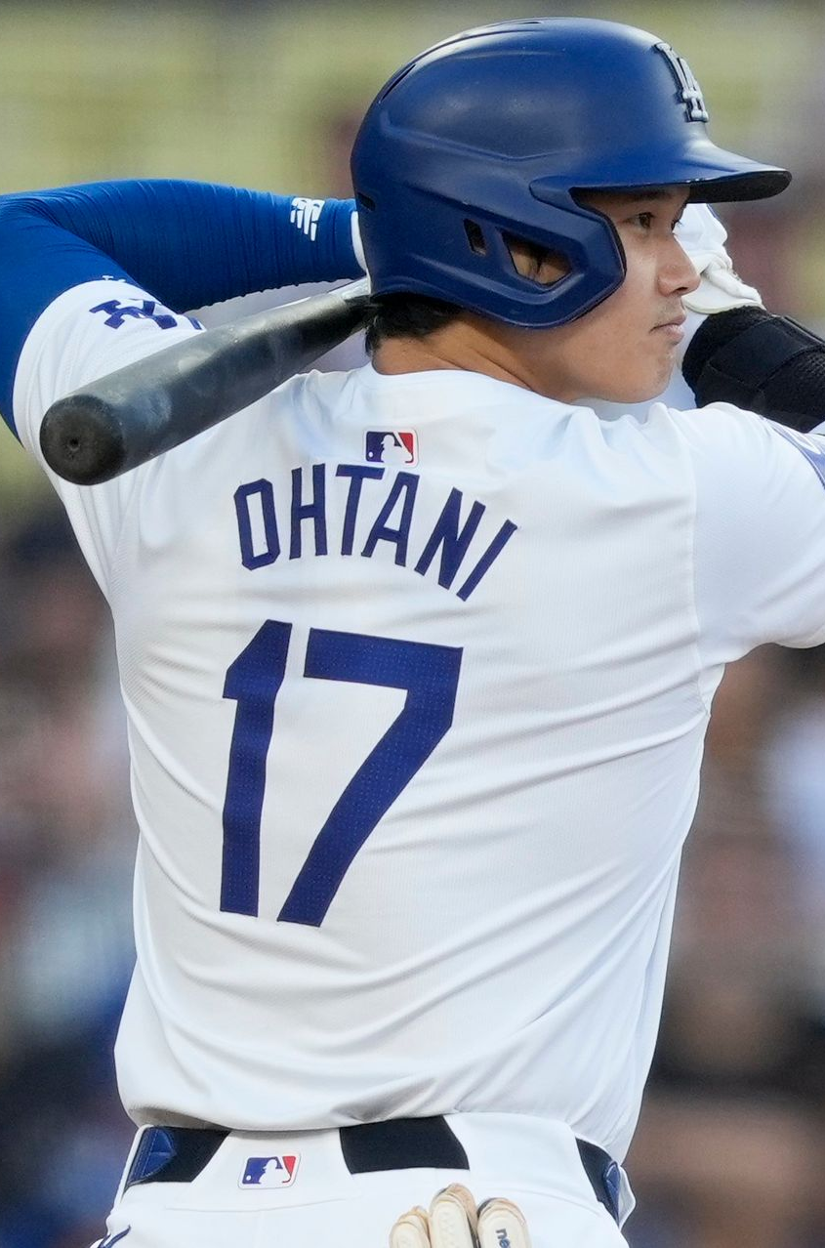
Issues Faced
Notable players not predicted (subjective):
Hitters:
Acuña
Betts
Goldschmidt
Harper
Judge
Ohtani
Ramirez
Soto
Pitchers:
Cole
Kimbrel
Ohtani
Sale

Slide 25
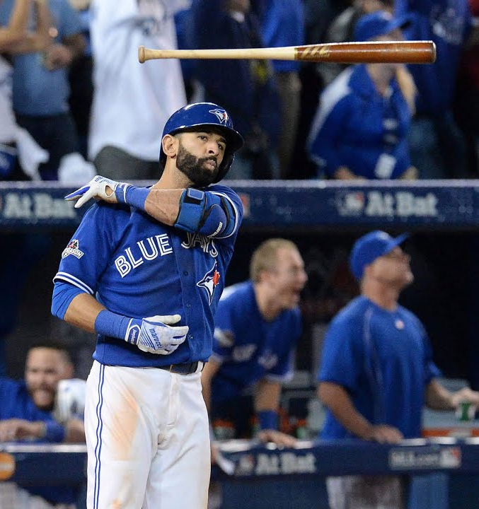
Thank you!
Questions?

Slide 26
References
https://stathead.com/baseball/player-batting-season-finder.cgi?request=1&match=player_season_combined&order_by_asc=1&order_by=name_display_csk&ccomp%5B1%5D=gt&cval%5B1%5D=162&cstat%5B1%5D=b_games&is_hof=N
https://stathead.com/baseball/player-pitching-season-finder.cgi?request=1&match=player_season_combined&order_by_asc=1&order_by=name_display_csk&ccomp%5B1%5D=gt&cval%5B1%5D=32&cstat%5B1%5D=p_g&is_hof=N
https://stathead.com/baseball/player-batting-season-finder.cgi?request=1&match=player_season_combined&order_by_asc=1&order_by=name_display_csk&is_hof=Y
https://stathead.com/baseball/player-pitching-season-finder.cgi?request=1&match=player_season_combined&order_by_asc=1&order_by=name_display_csk&is_hof=Y

